Slide 1


Good Eats vs Popular Eats
By: Albert Lee Ryan Chang David Wu Anjali Vardhan

Slide 2

Introduction
For our project, our team decided to work on a topic that is dear to our hearts/stomachs.....food. This lead to a discussion on which restaurants we liked and hated. This discussion was what sparked the idea for our project.
For many of us, we pick a restaurant based on word of mouth or on positive review online. Earlier this year, Yelp, a popular restaurant review site, added a restaurants’ health inspection score/grade to the restaurant’s review page.
With this new information now readily available, we wanted to see if this would have an impact on restaurant's popularity.

Slide 3


Questions
What is the correlation between restaurant inspection grades and popularity of the restaurant (number of Yelp reviews)?
Is there a correlation between inspection grading and Yelp $ signs?
What is the most common grade?
What type of food typically gets the highest grade?
Notes:
We posed the following four questions:

Slide 4

Hypothesis
The health score rating of a restaurant has a direct correlation to its popularity.
As the price point of a restaurant goes up, the health score rating will also go up.
The most common health score grade is a “B”
The most cleanliest type of restaurant serves French food.
Notes:
We hypothesized these 4:

Slide 5

County of Los Angeles Public Health
The mission of the Los Angeles County Public Health department is to protect and improve the health of Los Angeles County residents.
One of their duty is to conduct health inspections on all restaurants.
Restaurants are inspected anywhere from 1 to 3 times a year
Los Angeles County Environmental Health is responsible for inspections and enforcement activities for all unincorporated areas and 85 of the 88 cities in the County. This dataset does not include Pasadena, Long Beach or Vernon (each has its own city health department).
Results are updated and published on the department’s website
https://data.lacounty.gov/Health/LOS-ANGELES-COUNTY-RESTAURANT-AND-MARKET-INSPECTIO/6ni6-h5kp

Slide 6
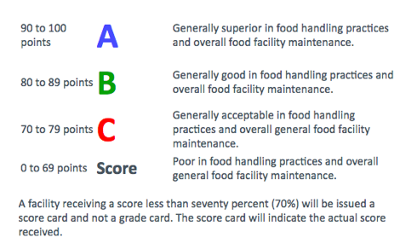

Do You Know Your ABC’s?
Notes:
Health Inspection Scores-Grade Criteria

Slide 7
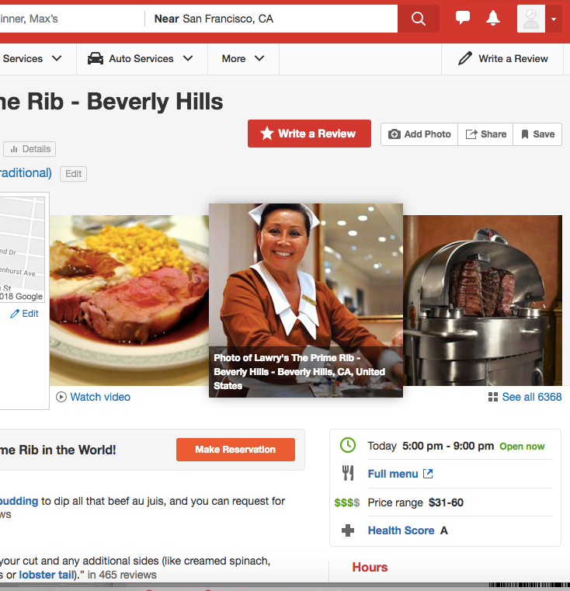

Yelp is a social networking site that is also serves as a business search engine. Yelp provides users with not only information about a business, but also allows users to post reviews and rate businesses.
Users rate business on scale of stars with 5 being the best and 1 being the worst.
Users can share their positive or negative reviews for anyone to read
www.yelp.com

Slide 8
Data Set
Original Data Set
Rows: 200,000
Columns: 20
Cleaning Criteria
Using only the latest activity date
Dropped 155,369
Using only “Active” status
Dropped 8,107
Using only business categorized as “Restaurants”
Dropped 9,949
Dropped restaurants designated as “Fast Food”
Dropped 4,004
Dropped restaurants designate as “N/A”
Dropped 9
Random Sample Set
5000
Further Cleaning
Dropped those that are under the 25th percentile
Dropped 1,267
Final data set
3,733 restaurants

Slide 9

Assumptions and Limitations
Not all “Fast Food” restaurants were dropped.
Only restaurants with “#” in name were dropped and categorized by us as “Fast Food”.
A restaurant’s total review count is symbolic of its popularity.
The dataset is limited to only 5000 restaurants due to Yelp’s API limitations.
Good or bad, it still shows that the reviewer patroned the restaurant.
Our conclusions is an extrapolation from our data.

Slide 10

Analysis
Average health grade
A
Average number of reviews per restaurant
415
Cleanliest restaurant type
Brazilian (95.5%)
Most common restaurant type
Mexican

Slide 11

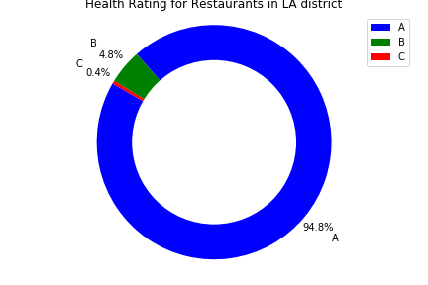
Restaurant Grade Breakdown

Slide 12

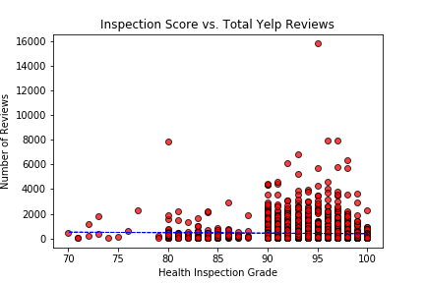


Reviews vs Health Scores
Notes:
ISA is a Japanese Restaurant is a little hole in the wall Japanese restaurant located on La Brea but obscured somewhat by the big car wash located at 916 South La Brea Ave that received a C with 463 reviews.
Seven miles away at 700 S. Grand Ave in Downtown LA is Bouttega Louie that has 15802 reviews that received an A grade.

Slide 13

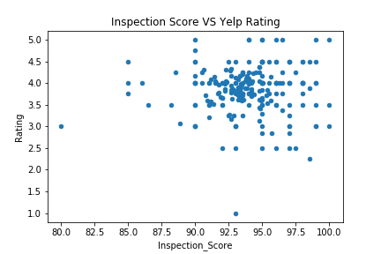
Health Scores vs Yelp Scores
No correlation between health scores and ratings.
Notes:
As one can see the graph, there is no correlation between the inspection scores and ratings as the bubble points are all over the place.

Slide 14

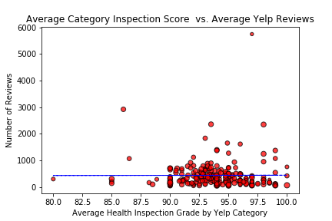
Restaurant Type vs Number of Reviews
Linear Regression Line
Linear Regression Line
Notes:
The blue line is linear regression, which is completely flat. Meaning it has a zero slope. This represents there is no relationship between the two variables: average health inspection scores by yelp category and number of reviews.

Slide 15

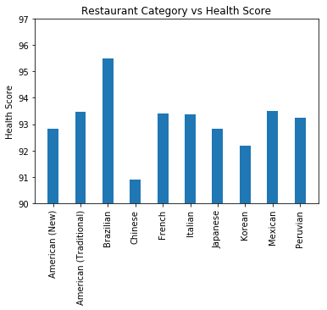
Restaurant Type vs Health Score
Notes:
The Star Indicates Brazillian receiving the highest health score in comparison to ten restaurant categories: American (New), American (Traditional), Brazillan, Chinese, French, Italian, Japanese, Korean, Mexican, and Peruvian.

Slide 16
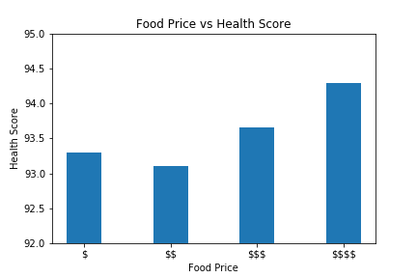

Food Prices vs
Health Scores
As Price Increases so does the health score.

Slide 17


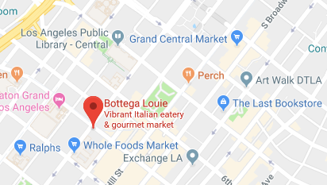
Conclusion
Most popular with highest health grade:
Bottega Louie
The average restaurant in LA county has an “A” health grade.
Health grade has no impact on a restaurants popularity
If the food is good, people will come.
Price makes a difference on a restaurants health score
Higher priced restaurant more likely to have a higher health score.

Slide 18


Slide 19

Resources
Los Angeles County Public Health
https://data.lacounty.gov/Health/LOS-ANGELES-COUNTY-RESTAURANT-AND-MARKET-INSPECTIO/6ni6-h5kp
Accessed on December 8, 2018
https://www.yelp.com
Accessed on December 8, 2018

Slide 20


